Slide 1
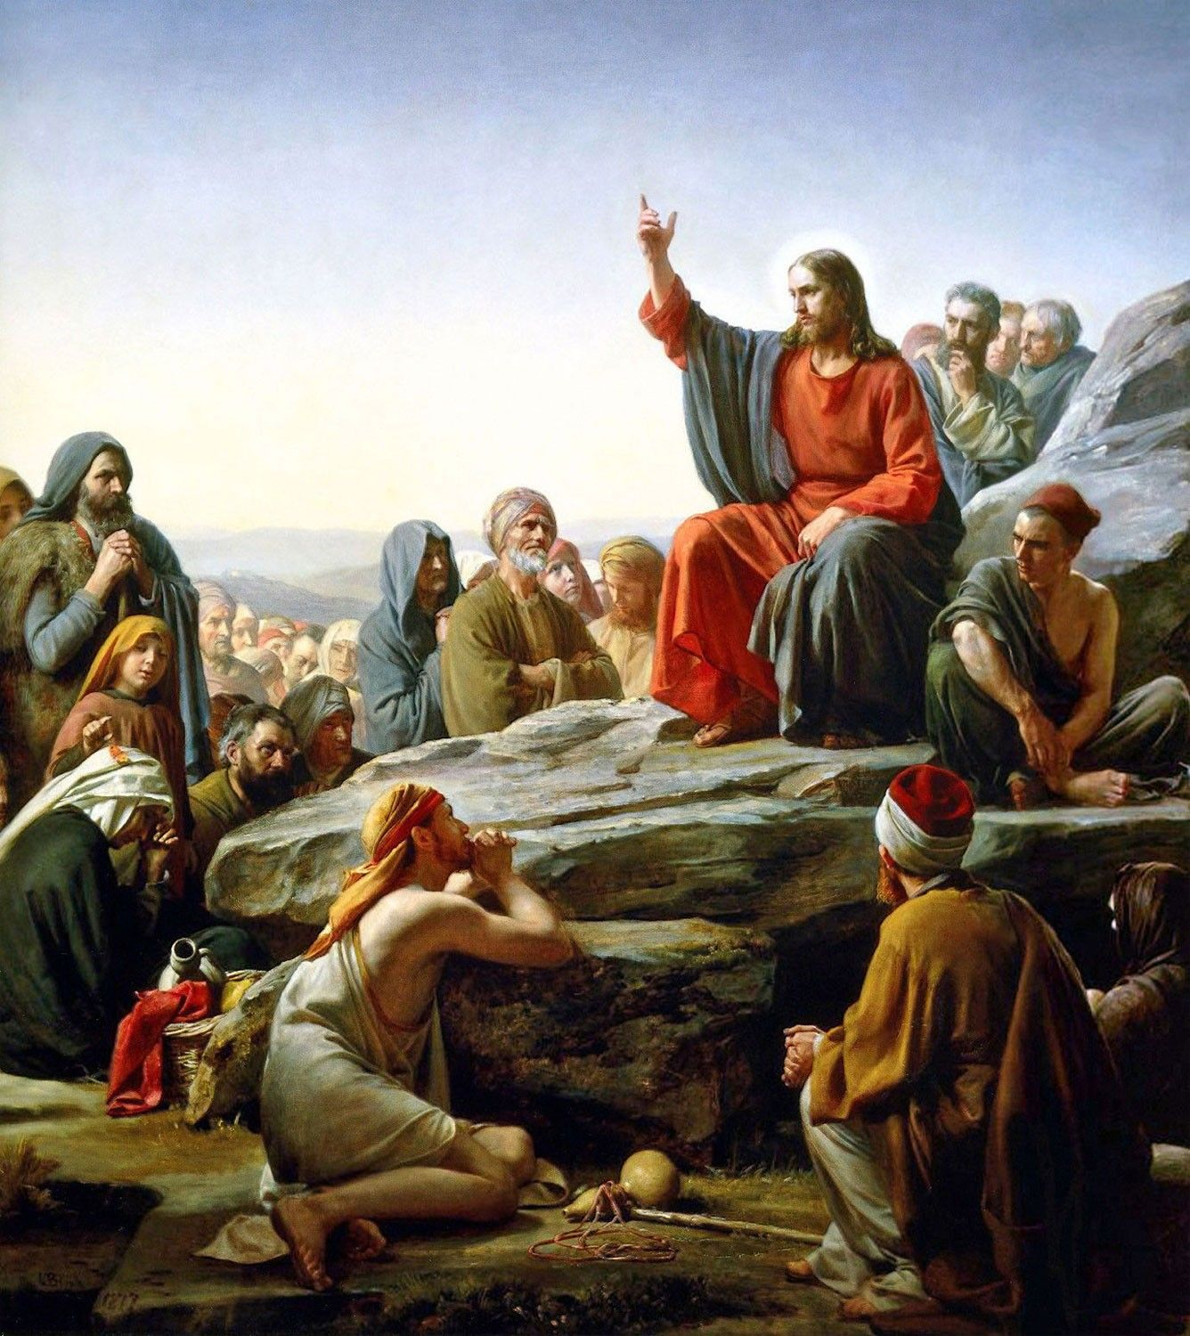
THE LIFE OF CHRIST
PART 20

Slide 2
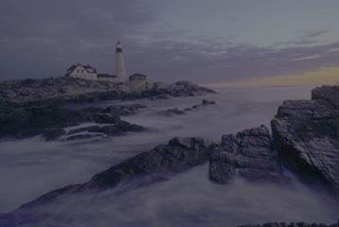
1. Friedrich Nietzsche (1844-1900), the German philosopher, looked upon the New Testament morals as a “malignant disease.”
2. George Bernard Shaw called the Sermon on the Mount an “impractical outburst of anarchism and sentimentality.”

Slide 3
3. Dispensationalists believe it to be for the future Kingdom, not for us.
A note in the Scofield Bible reads: “For these reasons the Sermon on the Mount in its primary application gives neither the privilege nor the duty of the Church.”
Yet, Jesus said “Blessed are those who are persecuted…”
Is this the “new earth”?

Slide 4
4. The Seventh Day Adventist turn this sermon into an extension of the Ten Commandments that were given on Mt. Sinai.
5. Others look at the sermon as a contrast to the Ten Commandments.

Slide 5
6. Some Christians turn it into a modern version of the Ten Commandments.
They have done to the Sermon of the Mount what the Jews did to the Law – they have drained the life right out of it.
They have turned it into a series of “Thou shalts” and “Thou shall nots.”
The Sermon on the Mount is one of the least understood, least followed teachings of Christ.
It contains meat for the mature and will challenge you as long as you live.

Slide 6
“It seems certain that no other speech ever delivered has so influenced man as has this sermon on the mount. Its contents, so superior to any production of man, proved the Deity of its author. Its teaching is out of harmony with any school of religion of philosophy of that day; hence there brightest lights could not have produced it. It is not eclectic, that is , its contents are not a collection of the best thoughts of that and previous ages. Its teaching is distinct, revolutionary, challenging every school of religious thought of the times, both Jewish and heathen. It is not a product of the times, but of Deity.” (R. L. Whiteside, Bible Studies, Vol. 4, p. 117).

Slide 7
Matthew 5:1 And seeing the multitudes, He went up on a mountain, and when He was seated His disciples came to Him.

Slide 8
The traditional site of this mountain is seven miles southwest of Capernaum; the place is known as The Horns of Hattin. Note the custom of sitting down to teach, a procedure that was long followed in the early church. Sitting to teach was an indication of authority. Dummelow noted that in the "early church, the preacher sat, and the congregation, including the emperor, stood."^{[1]} Most of the cathedrals of Europe are still without pews or other seating facilities for the congregation. The reformer, Martin Luther, alluded to this custom when he said, objecting to the Pope's remaining seated to observe the Lord's Supper, "Let him stand up when he takes the communion, like any other stinking sinner."

Slide 9
Matthew 5:2 Then He opened His mouth and taught them, saying: ³ "Blessed are the poor in spirit, For theirs is the kingdom of heaven. ⁴ Blessed are those who mourn, For they shall be comforted. ⁵ Blessed are the meek, For they shall inherit the earth. ⁶ Blessed are those who hunger and thirst for righteousness, For they shall be filled. ⁷ Blessed are the merciful, For they shall obtain mercy. ⁸ Blessed are the pure in heart, For they shall see God.

Slide 10
⁹ Blessed are the peacemakers, For they shall be called sons of God. ¹⁰ Blessed are those who are persecuted for righteousness' sake, For theirs is the kingdom of heaven. ¹¹ "Blessed are you when they revile and persecute you, and say all kinds of evil against you falsely for My sake. ¹² "Rejoice and be exceedingly glad, for great is your reward in heaven, for so they persecuted the prophets who were before you.

Slide 11
³ "Blessed are the poor in spirit, For theirs is the kingdom of heaven.

Slide 12
Proverbs 30:7 Two things I request of You (Deprive me not before I die): ⁸ Remove falsehood and lies far from me; Give me neither poverty nor riches -- Feed me with the food allotted to me; ⁹ Lest I be full and deny You, And say, "Who is the LORD?" Or lest I be poor and steal, And profane the name of my God.

Slide 13
1 Corinthians 3:18 Let no one deceive himself. If anyone among you seems to be wise in this age, let him become a fool that he may become wise.

Slide 14
Psalm 8:4 What is man that You are mindful of him, And the son of man that You visit him?

Slide 15
Philippians 3:3 For we are the circumcision, who worship God in the Spirit, rejoice in Christ Jesus, and have no confidence in the flesh, ⁴ though I also might have confidence in the flesh. If anyone else thinks he may have confidence in the flesh, I more so: ⁵ circumcised the eighth day, of the stock of Israel, of the tribe of Benjamin, a Hebrew of the Hebrews; concerning the law, a Pharisee; ⁶ concerning zeal, persecuting the church; concerning the righteousness which is in the law, blameless.

Slide 16
⁷ But what things were gain to me, these I have counted loss for Christ. ⁸ Yet indeed I also count all things loss for the excellence of the knowledge of Christ Jesus my Lord, for whom I have suffered the loss of all things, and count them as rubbish, that I may gain Christ ⁹ and be found in Him, not having my own righteousness, which is from the law, but that which is through faith in Christ, the righteousness which is from God by faith; ¹⁰ that I may know Him and the power of His resurrection, and the fellowship of His sufferings, being conformed to His death,

Slide 17
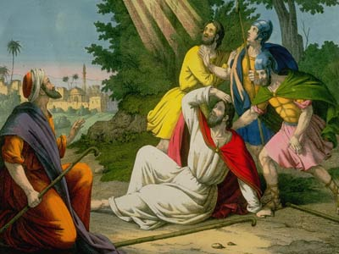

Slide 18
Blessed are those who mourn, For they shall be comforted.

Slide 19
BDAG to experience sadness as the result of some condition or circumstance, be sad, grieve, mourn. To engage in mourning for one who is dead,…

Slide 20
2 Corinthians 7:10 For godly sorrow produces repentance leading to salvation, not to be regretted; but the sorrow of the world produces death.

Slide 21
2 Corinthians 12:7 And lest I should be exalted above measure by the abundance of the revelations, a thorn in the flesh was given to me, a messenger of Satan to buffet me, lest I be exalted above measure. ⁸ Concerning this thing I pleaded with the Lord three times that it might depart from me. ⁹ And He said to me, "My grace is sufficient for you, for My strength is made perfect in weakness." Therefore most gladly I will rather boast in my infirmities, that the power of Christ may rest upon me.

Slide 22
Luke 19:41 Now as He drew near, He saw the city and wept over it, ⁴² saying, "If you had known, even you, especially in this your day, the things that make for your peace! But now they are hidden from your eyes. ⁴³ "For days will come upon you when your enemies will build an embankment around you, surround you and close you in on every side, ⁴⁴ "and level you, and your children within you, to the ground; and they will not leave in you one stone upon another, because you did not know the time of your visitation."

Slide 23
Psalm 40:1 To the Chief Musician. A Psalm of David. I waited patiently for the LORD; And He inclined to me, And heard my cry. ² He also brought me up out of a horrible pit, Out of the miry clay, And set my feet upon a rock, And established my steps. ³ He has put a new song in my mouth -- Praise to our God; Many will see it and fear, And will trust in the LORD.

Slide 24
Matthew 11:28 "Come to Me, all you who labor and are heavy laden, and I will give you rest. ²⁹ "Take My yoke upon you and learn from Me, for I am gentle and lowly in heart, and you will find rest for your souls. ³⁰ "For My yoke is easy and My burden is light."

Slide 25
⁵ Blessed are the meek, For they shall inherit the earth.

Slide 26
BDAG …to not being overly impressed by a sense of one’s self-importance, gentle, humble, considerate,

Slide 27
^{ASV} Numbers 12:3 Now the man Moses was very meek, above all the men that were upon the face of the earth.

Slide 28
1 Peter 5:5 …"God resists the proud, But gives grace to the humble."

Slide 29
Psalm 37:3 Trust in the LORD, and do good; Dwell in the land, and feed on His faithfulness. ⁴ Delight yourself also in the LORD, And He shall give you the desires of your heart. ⁵ Commit your way to the LORD, Trust also in Him, And He shall bring it to pass. ⁶ He shall bring forth your righteousness as the light, And your justice as the noonday. ⁷ Rest in the LORD, and wait patiently for Him; Do not fret because of him who prospers in his way, Because of the man who brings wicked schemes to pass. ⁸ Cease from anger, and forsake wrath; Do not fret -- it only causes harm.

Slide 30
⁹ For evildoers shall be cut off; But those who wait on the LORD, They shall inherit the earth. ¹⁰ For yet a little while and the wicked shall be no more; Indeed, you will look carefully for his place, But it shall be no more. ¹¹ But the meek shall inherit the earth, And shall delight themselves in the abundance of peace.

Slide 31
Philippians 2:1 Therefore if there is any consolation in Christ, if any comfort of love, if any fellowship of the Spirit, if any affection and mercy, ² fulfill my joy by being like-minded, having the same love, being of one accord, of one mind. ³ Let nothing be done through selfish ambition or conceit, but in lowliness of mind let each esteem others better than himself. ⁴ Let each of you look out not only for his own interests, but also for the interests of others. ⁵ Let this mind be in you which was also in Christ Jesus, ⁶ who, being in the form of God, did not consider it robbery to be equal with God,

Slide 32
⁷ but made Himself of no reputation, taking the form of a bondservant, and coming in the likeness of men. ⁸ And being found in appearance as a man, He humbled Himself and became obedient to the point of death, even the death of the cross. ⁹ Therefore God also has highly exalted Him and given Him the name which is above every name, ¹⁰ that at the name of Jesus every knee should bow, of those in heaven, and of those on earth, and of those under the earth, ¹¹ and that every tongue should confess that Jesus Christ is Lord, to the glory of God the Father.

Slide 33
Colossians 3:12 Therefore, as the elect of God, holy and beloved, put on tender mercies, kindness, humility, meekness, longsuffering; ¹³ bearing with one another, and forgiving one another, if anyone has a complaint against another; even as Christ forgave you, so you also must do. ¹⁴ But above all these things put on love, which is the bond of perfection.

Slide 34
In the time of our Savior they were in the constant habit of using the Old Testament, where the promise perpetually occurs, and they used it as a proverbial, expression to denote any great blessings, perhaps as the sum of all blessings. Ps. 37:20; Isa. 60:1. Our Savior used it in this sense, and meant to say, not that the meek would own great property or have many lands, but that they would posses peculiar blessings. The Jews also considered the land of Canaan as a type of heaven, and of the blessings under the Messiah. To inherit the land became, therefore, an expression denoting those blessings. When our Savior uses this language here, he means that the meek shall be received into his kingdom, and partake of its blessings here, and of the glories of the heavenly Canaan hereafter. (Albert Barnes, Matthew and Mark, p. 44).

Slide 35
Inherit the earth ... does not refer exclusively to the "new heaven and the new earth" (2 Peter 3:13), but to this present earth as well. This is not a mere prophecy that the Christians shall be the landed gentry; but it is a statement that their relationship to the earth and its possessions shall be such as to bring them the greatest possible benefit and enjoyment of it.

